Slide 1
Conference on Recent Trends in Science, Technology and Innovation
Institute of Forestry Pokhara Campus (IOF PC), Pokhara
Feb 22-23, 2024
A Comprehensive Research on
“Vehicle Crash Detection and Alert System”
Authors:
Manish Chhetri, Nirajan Paudel, Nabaraj Subedi, Sudarshan Acharya,
Nabin Lamichhane, Khem Raj Koirala
hsinam12man34@gmail.com

Slide 2
Outline
Introduction
Objectives
Background Theory
Literature Review
Requirement Analysis
Methodology
System Architecture
Implementation Details
Result and Conclusion
References

Slide 3
Introduction
With the increasing number of road accidents and their impact on human lives and property, there is a critical need for advanced safety systems in vehicles which includes:-
Swift accident detection and rescue center alert.
Reports live location and driver's facial images and condition.
Utilizes sensors, communication networks, and AI for facial detection.
Enhances emergency response efficiency.

Slide 4
Introduction
How does crash detection system work?
Sensors for Monitoring:
Cameras observe driver drowsiness by analyzing facial expressions and eye movements.
Accelerometers , GPS Sensor and SIM800L are integrated to sense the impact forces associated with a crash and sends alert.
Crash Detection Process:
First, it verifies the event to prevent false alarms by sending notification to mobile application of driver.
If a genuine crash is confirmed, the system proceeds to alert the relevant parties.

Slide 5
Objectives
The Objective are:
To design and develop a crash detection system that can accurately and timely detect crash events and,
To notify the appropriate parties without delay and thus, improving the vehicle and the road safety.

Slide 6
Background Theory
It is based on camera technology, sensor technology, detection algorithm and communication networks.
Camera: It continuously scans the driver’s face to check the drowsiness detection.
Sensor Technology: Accelerometers measures acceleration and rotational movements, respectively, while GPS sensors provide location information.

Slide 7
Background Theory
Crash Event Detection: The crash detection algorithm compares the sensor data against the predefined thresholds to determine if a crash event has occurred.
Communication Networks: Cellular networks communication protocols facilitate the transmission of crash notifications to relevant parties.

Slide 8
Literature Review
Paper Title | Authors | Components Used | Key Findings
A Review of Crash Detection and Emergency Notification Systems for Motor Vehicles (2017) | Johnson et al. | Accelerometers, gyroscopes, GPS sensors, cellular networks | Emphasizes accurate crash detection and timely notification for improved emergency response.
Real-Time Crash Detection and Reporting System for Vehicles using Arduino and GSM Technology (2019) | Sathiyamoorthy et al. | Accelerometer, GSM module, GPS module, Arduino Nano microcontroller | Successful implementation of a cost-effective crash detection system that sends notifications to emergency contacts.
A Smart Crash Detection and Alert System for Vehicles (2020) | Saxena et al. | Accelerometer, GSM module, GPS module, Arduino Uno | Potential to reduce response time and save lives by triggering alerts and providing real-time location information.

Slide 9
Requirement Analysis
Functional Requirements
Drowsiness Detection: The camera module continuously detects the facial expression of the driver and thus alerting the driver using buzzer.
Crash Detection: The system should accurately detect frontal collisions based on sensor data analysis.
Thresholds and Parameters: Determine the appropriate thresholds and parameters for crash detection, such as change in acceleration.

Slide 10
Requirement Analysis
Functional Requirements
Communication: Establish a reliable communication mechanism to transmit crash notifications, considering options like cellular networks and Bluetooth module.
Integration: Integrate the crash detection system with vehicle safety systems
Notification: The system should promptly notify relevant parties, such as rescue center and designated contacts, about the occurrence of a crash event.

Slide 11
Methodology
Data Acquisition: Collect various sensor data ( Acceleration, angular Velocity, GPS coordinates) and images for drowsiness prediction.
Crash Detection Algorithm: Use an algorithm to detect accidents based on sensor data.
Threshold Determination: Determine Threshold values through extensive testing.
Magnitude = √ [ (X₂ – x₁)² + (y₂ – y₁)² + (z₂ – z₁)² ]

Slide 12
Methodology
Crash Event Detection: Compare sensor data against thresholds to identify crash events.
Notification and Communication : Tigger Notification Module and send crash notification, also include the drowsiness driver’s image
Emergency Response: Notified parties can initiate appropriate emergency response procedures.

Slide 13
System Architecture
Hardware Components:
Arduino UNO
MPU 6050
SIM 800L
NEO 6M
LM2596 DC-DC Buck Converter Step-Down Power
Jumper Wire
Bread Board

Slide 14
System Architecture
Software Components:
Deep learning model to analyze the drowsiness of driver’s face.
Mobile application to prevent the false accident detection.

Slide 15
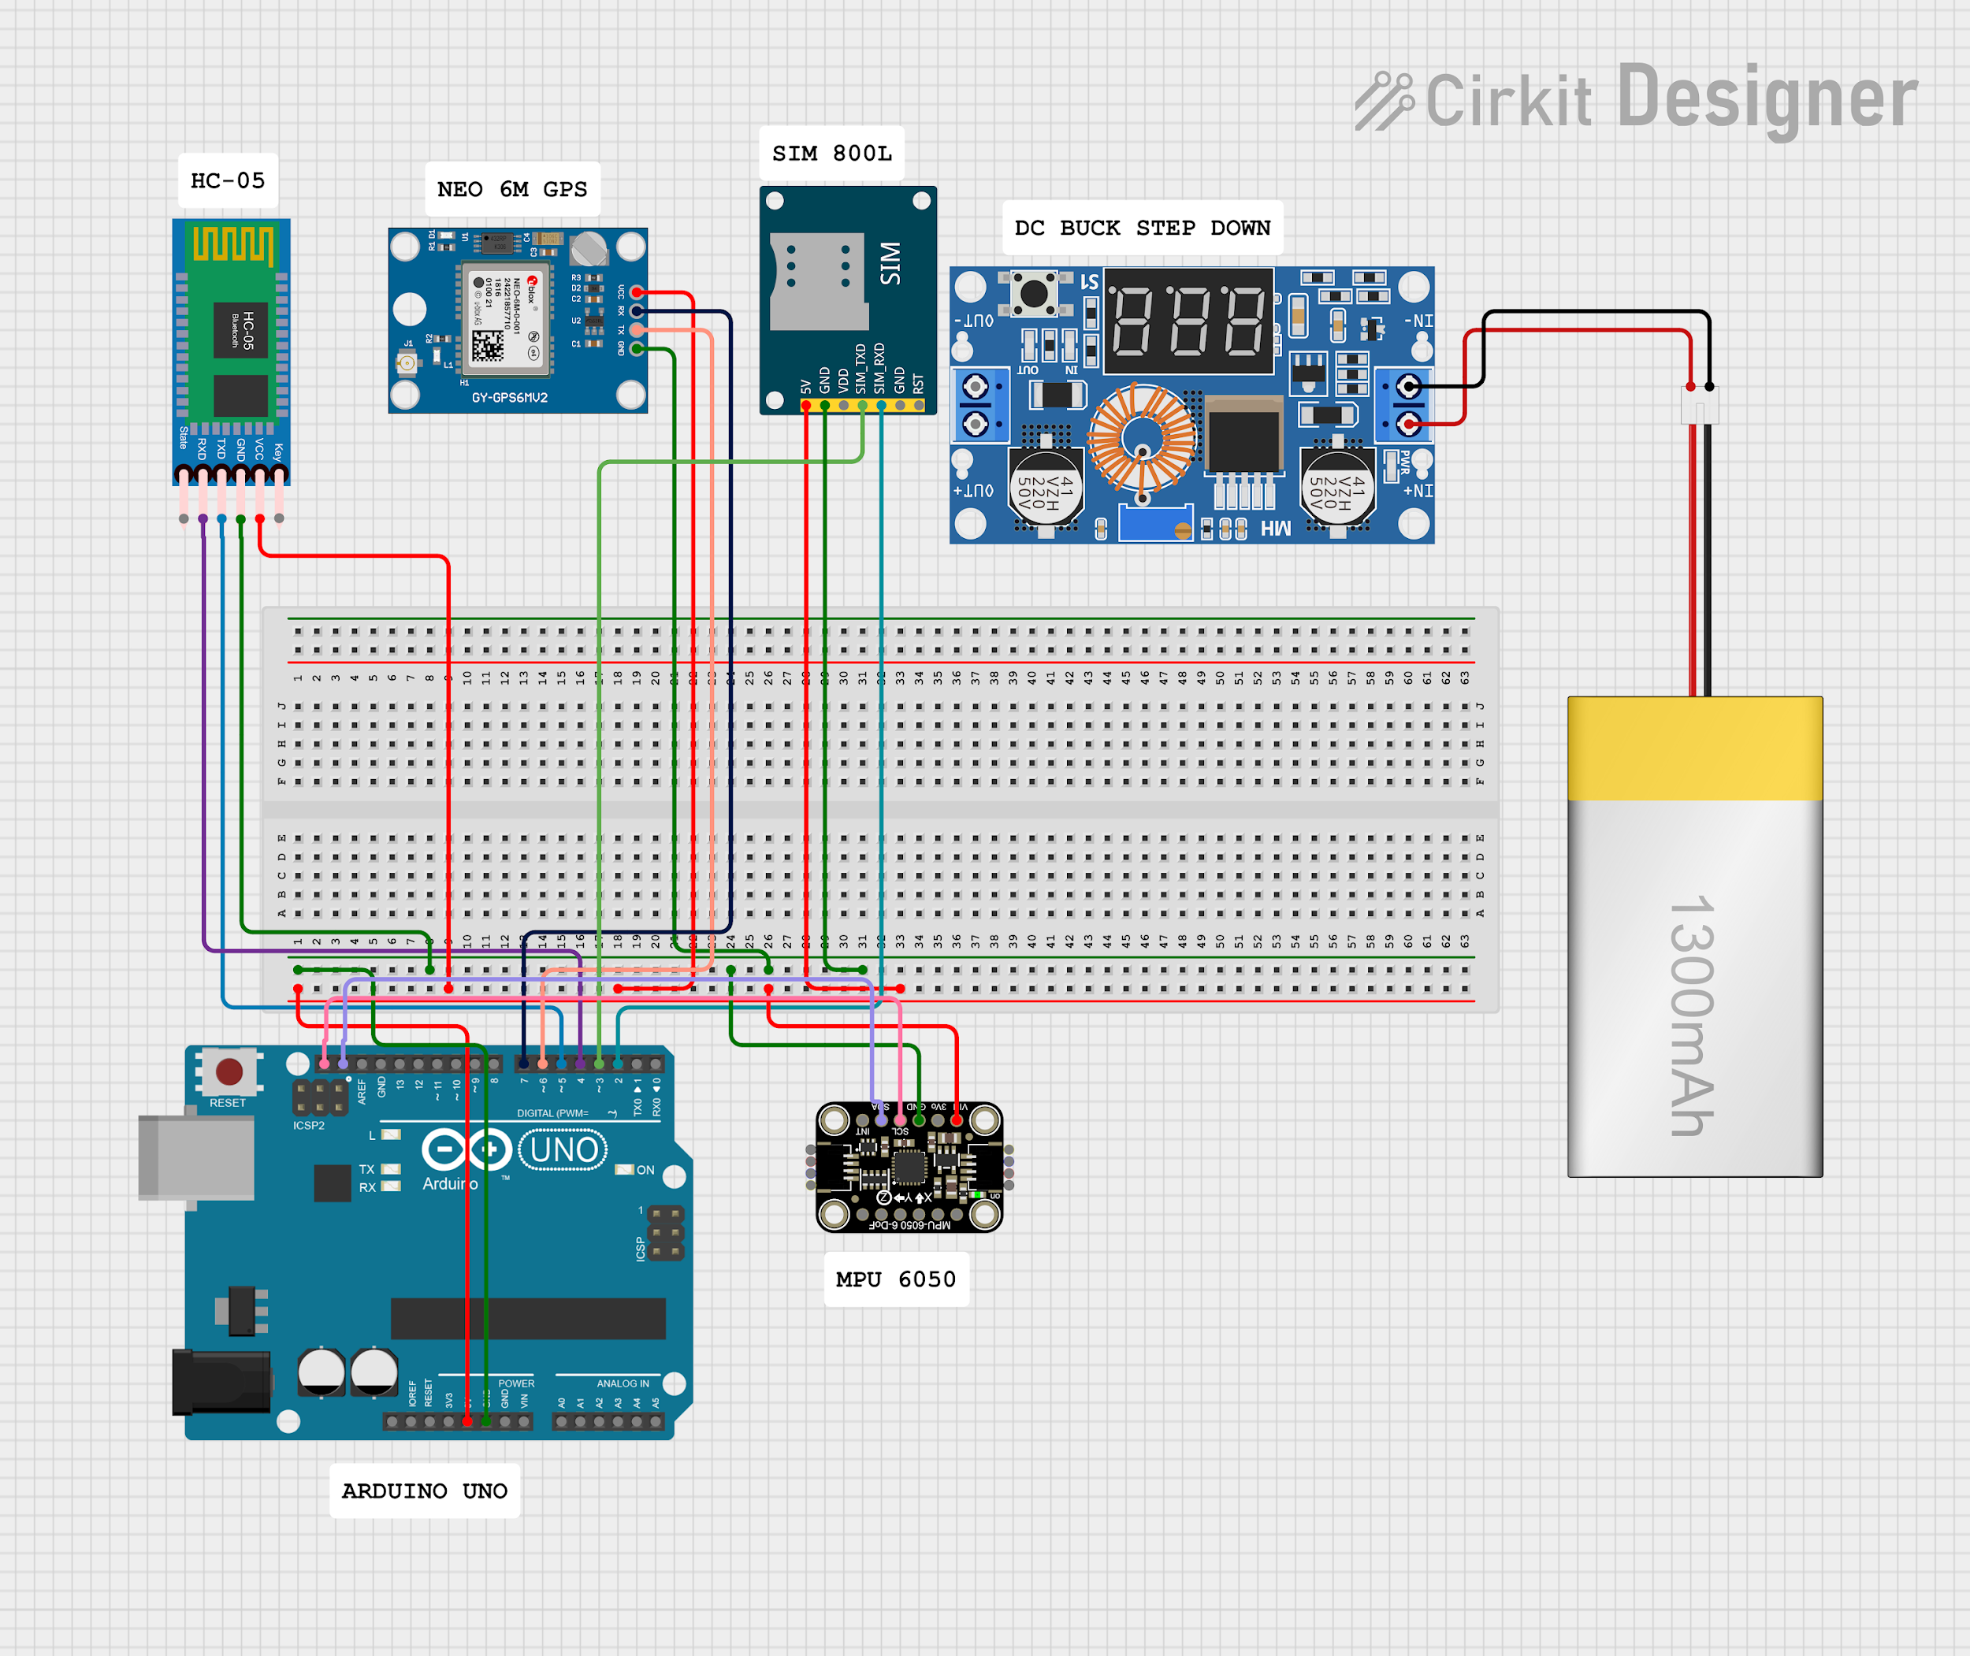
Hardware Component
Fig: Circuit Diagram

Slide 16
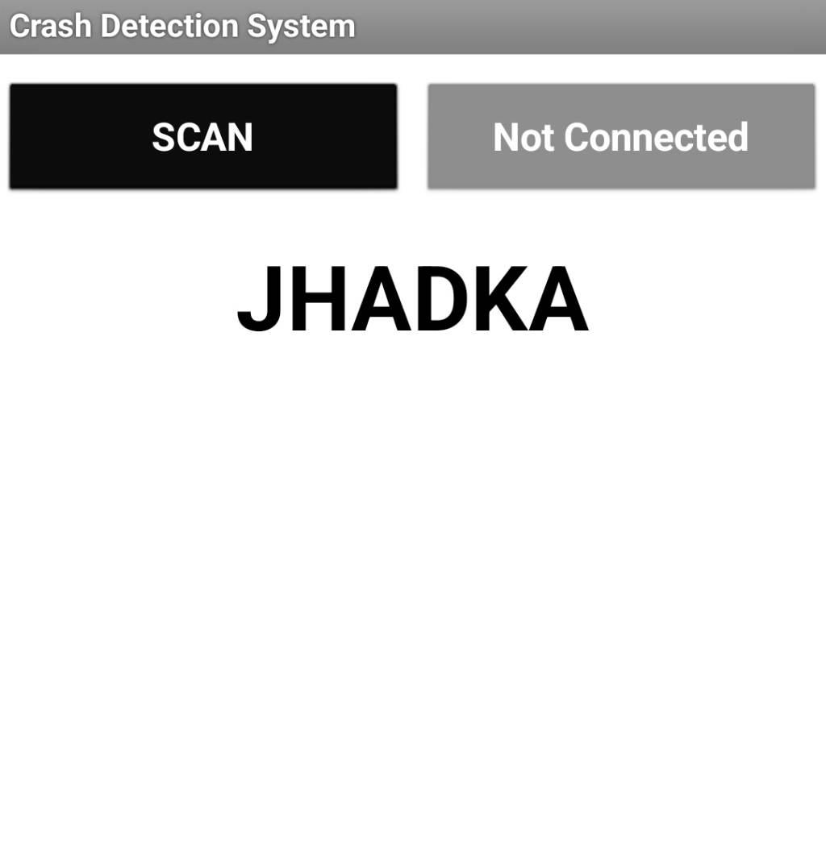
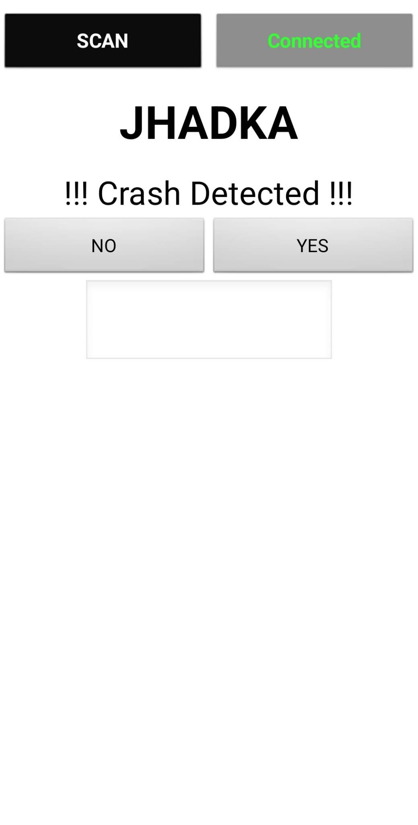
Software Component
Mobile Application:
Interface (Home page)
Option to choose

Slide 17
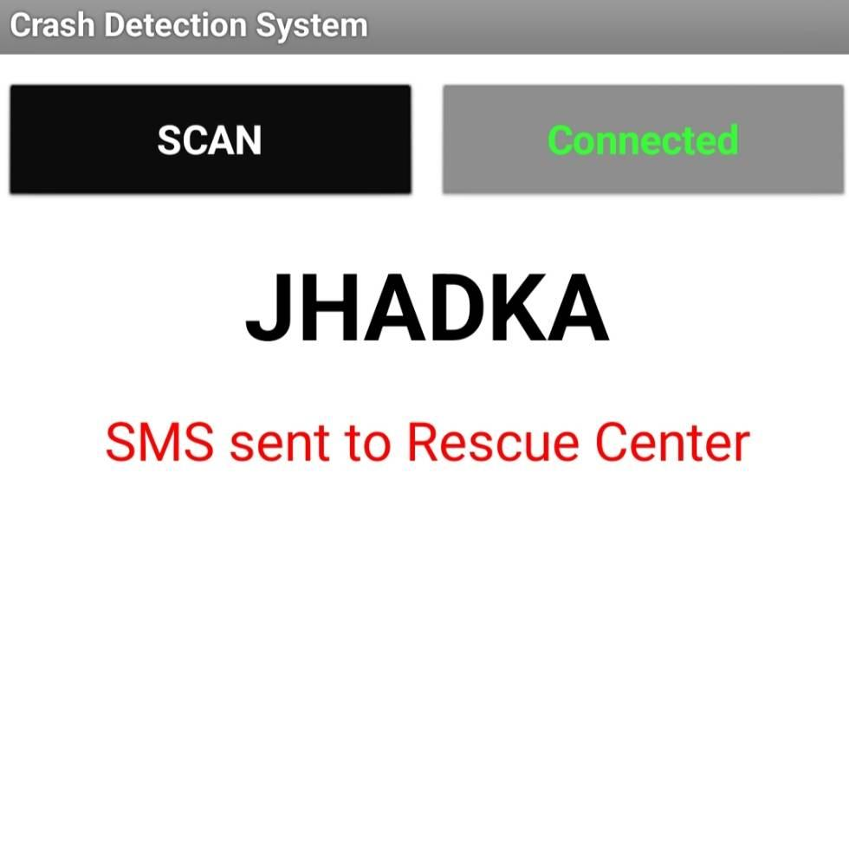
Software Component
Mobile Application:
yes

Slide 18
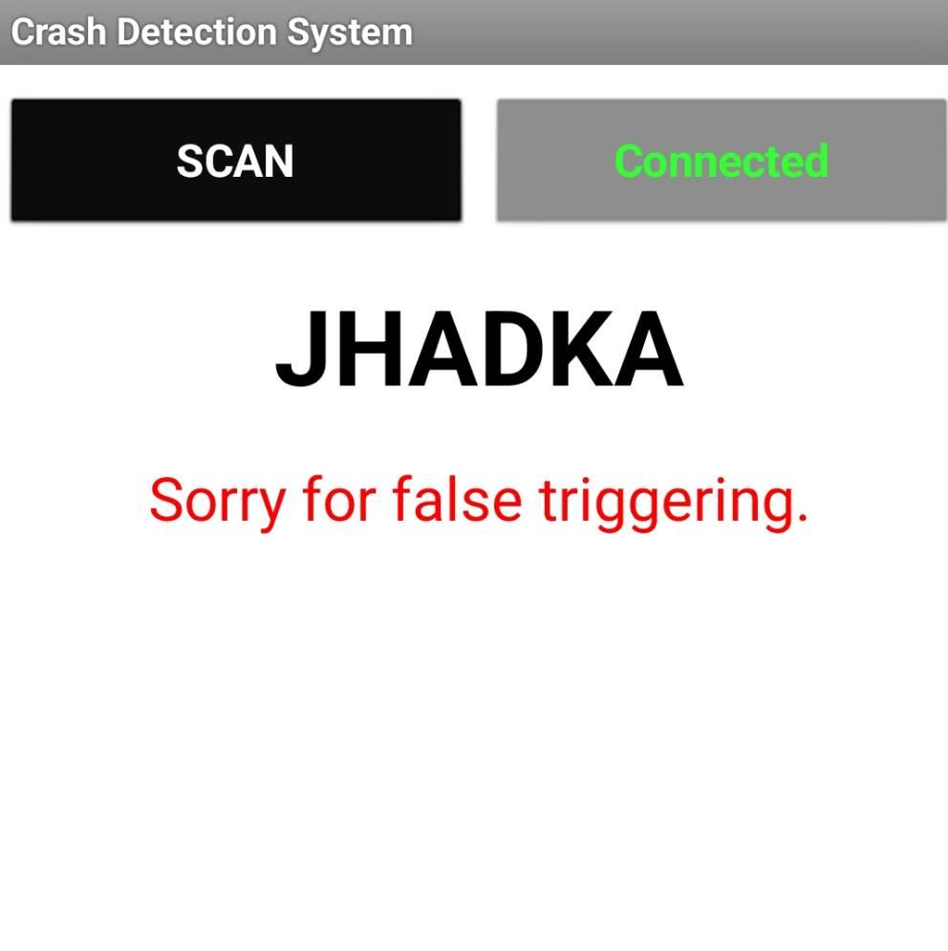
Software Component
Mobile Application:
No

Slide 19
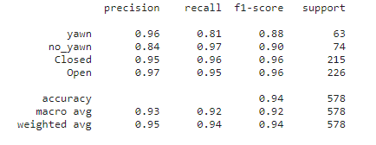
Software Component
Drowsiness Detection Model
.
Used approximately 1900 labeled images dataset from the kaggle.
Labels represented as 0, 1, 2, 3 for ["yawn", "no_yawn", "Closed", "Open"].
Split datasets into train and test sets.
Trained the model with train images, achieving an overall 94% test accuracy.
fig: Classification Report
Feb, 2024

Slide 20
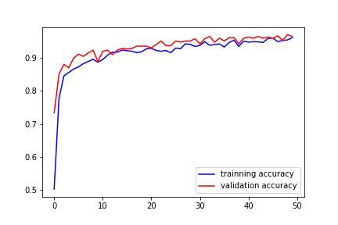
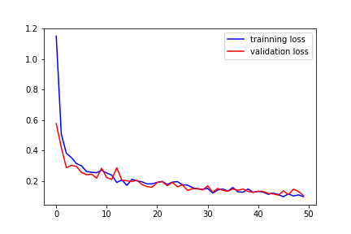
Software Component
accuracy
Loss
epoch
epoch
Fig: Accuracy and Loss Plot

Slide 21
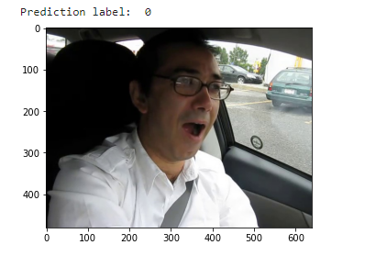
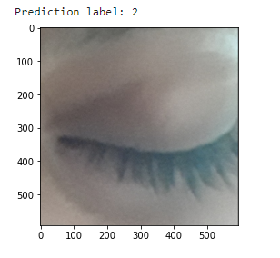
Software Component
Model Prediction
["yawn", "no_yawn", "Closed", "Open"].

Slide 22
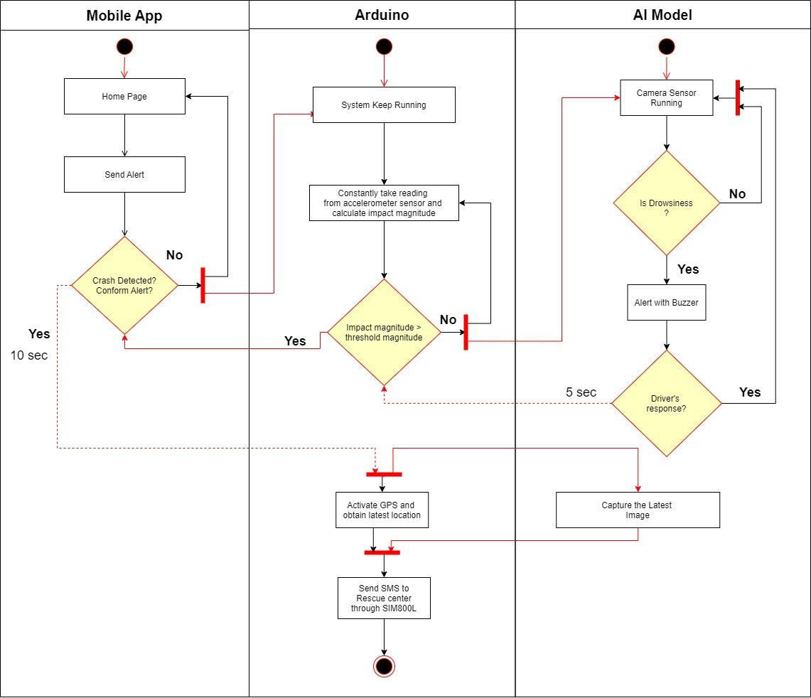
Fig: Activity diagram of crash detection system

Slide 23
Implementation Details
Sensor Selection
Crash Detection Algorithms
Threshold Determination
Real-Time Processing
Location Unit
Communication and Notification
Integration with Vehicle Systems

Slide 24
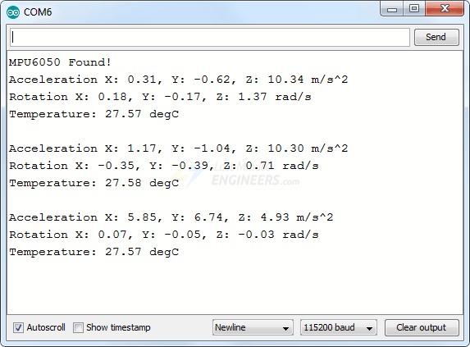
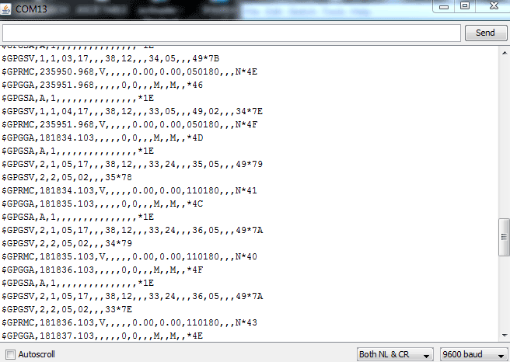
Implementation Details
Reading From MPU6050
Readings from Neo 6M

Slide 25
Result and Conclusion
The system detects crash and send notification to rescue center after confirmation from mobile application.
The crash detection system has shown promising results in term of accuracy, response time and reliability significantly.
Advancement in sensor technologies (LiDAR, Radar), incorporation of vehicle telematics (Speed, Breaking Pattern), and integration of ML algorithms for predictive analysis of historical data are potential areas of further improvements.

Slide 26
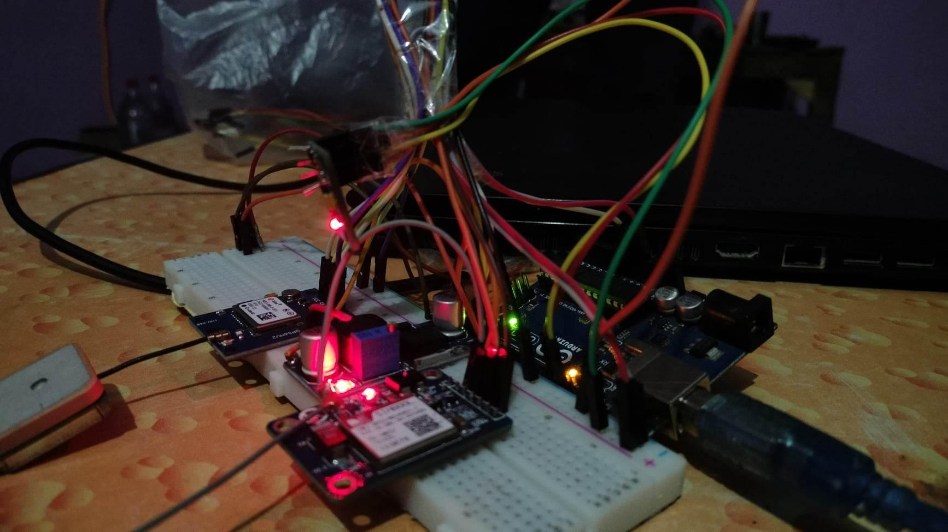
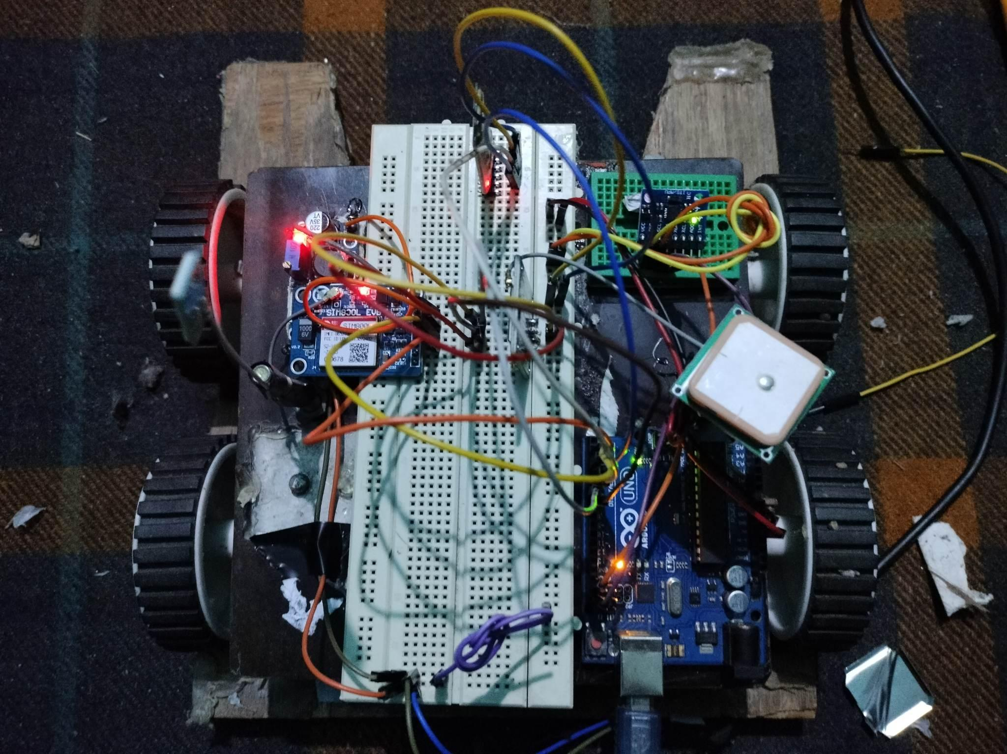
Snapshots

Slide 27
References
Ahmed, M. R., Raja, M. A. Z., Ali, M. A., & Islam, M. N. (2017). Development of a Crash Detection and Notification System for Vehicles. International Journal of Scientific Research in Computer Science, Engineering and Information Technology, 3(4), 1841-1847.
Kumar, N., Narayanan, N., & Rana, M. S. (2018). A Wireless Crash Detection and Reporting System for Automobiles using Arduino and GSM. International Journal of Emerging Technologies in Engineering Research, 6(12), 83-86.
Johnson, A., Smith, B., & Williams, C. (2017). A Review of Crash Detection and Emergency Notification Systems for Motor Vehicles. International Journal of Computer Science and Information Security, 15(4), 107-113.
Singh, A. K., Singh, A. K., & Singh, V. K. (2017). Accident detection and alert system using accelerometer and GSM. International Journal of Innovative Technology and Research, 6(1), 137-141.
Saxena, A., Agarwal, S., Singh, H., & Verma, R. (2020). A Smart Crash Detection and Alert System for Vehicles. International Journal of Innovative Technology and Exploring Engineering, 9(3), 1206-1209.

Slide 28
Thank You

